Slide 1
Company Network System
Submitted by
Name : Nur-A Khadija Khandaker
ID : 222400003
Submitted to
Name : Momtaj Hossain Mow(Lecturer)
Eastern University

Slide 2
Introduction
Rapid digitalization has made structured network design crucial.
This project simulates a real-world enterprise network.
It focuses on reliability, scalability, and security.
Implemented using Cisco Packet Tracer.

Slide 3
Objective
Design a secure and scalable company network.
Implement VLANs for departmental separation.
Ensure internet access via dual ISPs.
Demonstrate real-time communication among departments.
Use routing protocols and security measures effectively.

Slide 4
Project Overview
A three-story company building.
Departments distributed across floors:
1st Floor: Sales, HR & Logistics
2nd Floor: Finance, Admin & PR
3rd Floor: ICT Department & Server Room
Centralized internet access via two ISPs.

Slide 5
Network Design Overview
VLAN segmentation for each department.
Inter-VLAN routing using multilayer switches.
IP address management via DHCP.
Dual ISP connectivity with redundancy.

Slide 6
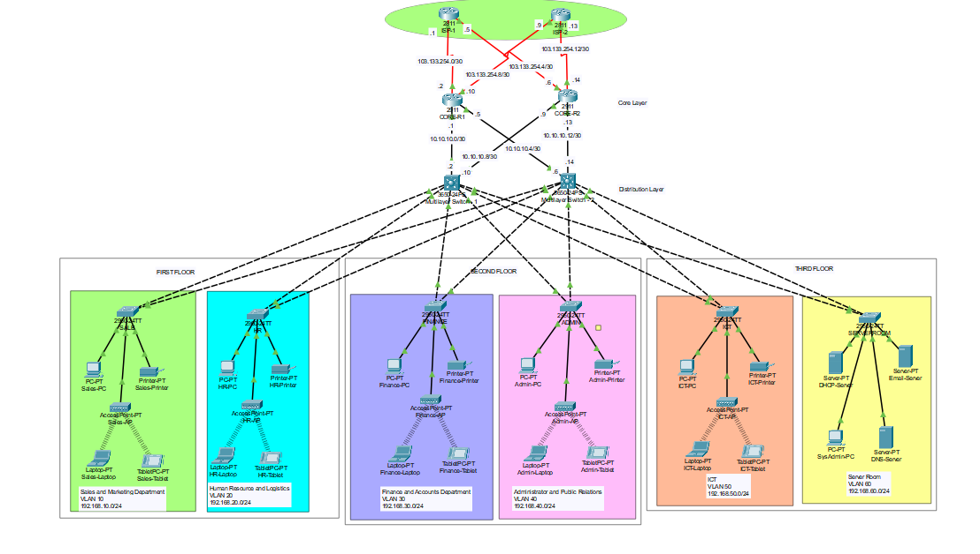
Network Diagram

Slide 7
Key Technologies
VLANs – Logical separation of departments.
Inter-VLAN Routing – Using multilayer switches.
OSPF – For dynamic routing.
NAT – Private to public IP translation.
SSH & ACLs – For secure remote access and control.
Port Security – Protecting switch ports from unauthorized access.

Slide 8
IP Addressing
Used Class C private IP addresses.
Subnetting to efficiently allocate addresses.
DHCP enabled for automated host IP assignment.
Static addressing for core devices (routers/switches).

Slide 9
ISP Configuration
Connected with ISP1 and ISP2.
Both ISPs linked with static routing.
Failover ensured through dual gateway setup.
NAT used to access external web servers.

Slide 10
Security Implementations
SSH Configuration: All routers and multilayer switches are configured with SSH for secure remote access.
Access Control Lists (ACLs): Implemented to control traffic flow and enhance security.
Port Security: Enabled on switches, especially in the Finance and Accounts department, to restrict access based on MAC addresses.
Network Address Translation (NAT): Configured to allow internal devices to access external networks securely.

Slide 11
Routing Protocol
Used Open Shortest Path First (OSPF) for dynamic routing.
Fast convergence and better path selection.
Facilitates inter-VLAN communication.
Helps scalability for future expansion.

Slide 12
Testing and Validation
Successful inter-department communication.
Internet access from all floors.
Redundant ISP setup worked in failover tests.
Secure SSH login and ACL filtering verified.
No IP conflict or broadcast storm observed.
Reliable internet connectivity through both ISPs.

Slide 13
Conclusion
The project successfully demonstrates a realistic company network.
Key aspects like VLANs, routing, and security were effectively implemented.
Scalable and secure network design achieved.
Ready for real-world enterprise network deployments.

Slide 14
Thank You
Thank you for your attention!

